Slide 1
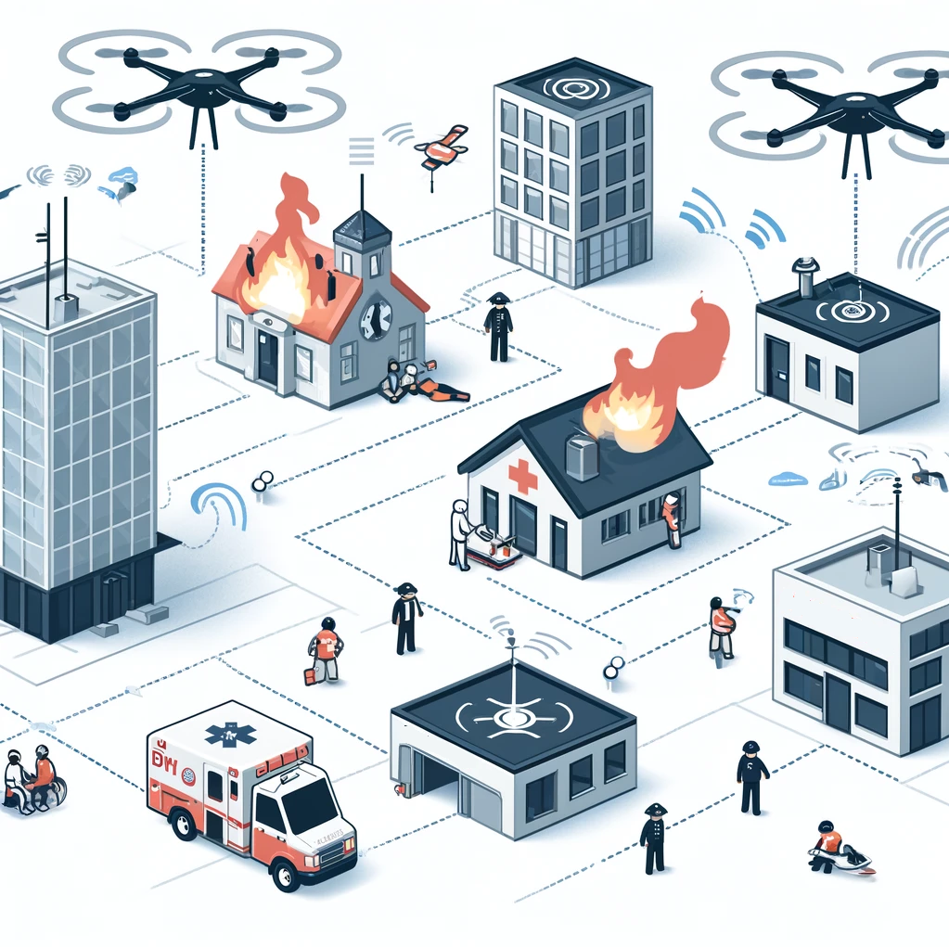
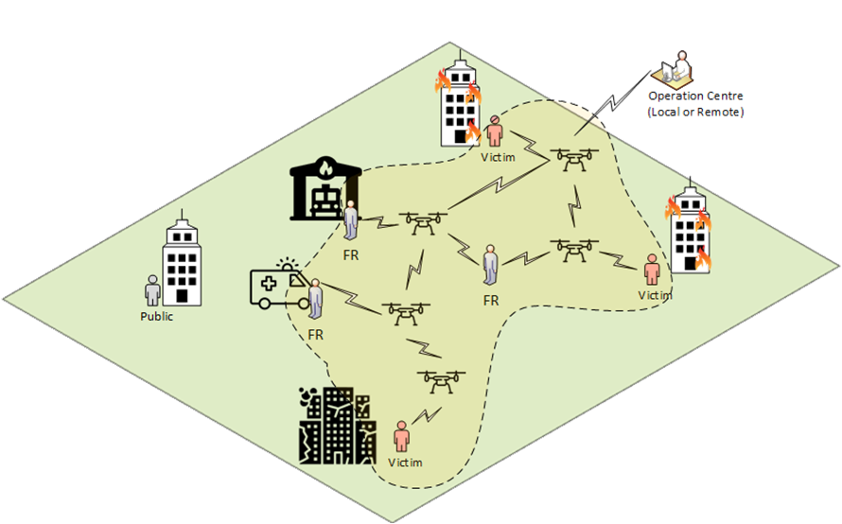


AI Enhanced Decision Support Using Swarm Robotics in Disaster Management
DisasterAware
Çağlar AKMAN
Supervisor: Prof. Dr. Kemal Leblebicioğlu
Electrical and Electronics Engineering Department
Middle East Technical University

Slide 2
Outline
Problem Definition & Challenges
Work Done (Demo Videos)
Work Done
Work Plan and Future Work

Slide 3


Problem Definition and Research Topics
Objective
Develop a real-time adaptive decision support system that continuously modifies its logic and structure based on live field data (e.g., during disasters). Unlike static decision trees, it evolves dynamically to reflect changing conditions.
Environmental Adaptation
Decision Trajectory Intervention
Dynamic Tree Modification
Learning from Feedback
Adjusts decision logic based on real-time sensor or event data (e.g., wind, fire).
Can insert, delete, or revise decisions in an ongoing decision sequence (trajectory).
Adds/removes/reconfigures decision nodes and branches on the fly—no downtime.
Continuously learns from past outcomes via reinforcement learning to improve decisions over time.
Notes:
The prominent gaps of the existing EWS [2] and capabilities of FRs [3] are (i) “capacity of remote monitoring, coverage and sustainability of observation”, (ii) “localization of FR’s and incidents”, (iii) “rapid detection of incidents and response capability”, and (iv) “simulation exercises for preparedness”.

Slide 4
Problem Definition and Research Topics
 |  | 1 | 2 | 3 | 4 | 5
 |  | Spring | Fall | Spring | Fall | Spring
T1 | Literature Search
T2 | Decision Tree – Data categorization
T3 | AI – Enhanced Simulation Environment
T4 | AI – Enhanced Algorithm Development (Fuzzy, Generative AI, Reinforcement Learning)
T5 | Simulation and Tests
T6 | Article
Notes:
The prominent gaps of the existing EWS [2] and capabilities of FRs [3] are (i) “capacity of remote monitoring, coverage and sustainability of observation”, (ii) “localization of FR’s and incidents”, (iii) “rapid detection of incidents and response capability”, and (iv) “simulation exercises for preparedness”.

Slide 5
1. Literature Research & Contributions
Contribution | Description
Development of a Hybrid RL–LLM Architecture | Integrates Reinforcement Learning for policy optimization and Large Language Models for interpretable explanations in real-time disaster decision-making.
Integration of Fuzzy Logic for Human-Centric Uncertainty Reasoning | Embeds fuzzy logic into decision nodes to handle vague, imprecise, or linguistically expressed inputs (e.g., “high risk,” “low visibility”) and enables the system to operate effectively under partial observability. Reinforcement Learning tunes membership functions, while LLMs convert fuzzy inferences into interpretable explanations.
Real-Time Structural Adaptation of Decision Graphs | Implements dynamic decision graph topology updates using GNNs and RL, enabling adaptation to evolving wildfire scenarios.
Formalization of Explainable, Mathematically-Constrained Decision Nodes | Defines decision nodes with explicit cost-time-resource constraints and uses LLMs to produce human-readable justifications.
Conceptualization of an Adaptable Decision Graph Framework | Proposes a non-static decision graph structure that learns optimal decision sequences using RL and supports modular reuse.
Integration of Multi-Phase Wildfire Management | Extends DSS capabilities to all disaster phases with phase-aware policies learned by RL and phase summaries generated by LLMs.
Scalable and Transferable Modular AI-DSS Architecture | Designs AI components for reuse across different disaster types with modular data pipelines and inference models.
Contribution to Explainable AI in Safety-Critical Environments | Aligns symbolic mathematical models with LLMs to deliver accountable, transparent decisions under operational pressure.
High-Fidelity Simulation Environment for Evaluation | Provides a simulated wildfire environment for RL policy training, LLM response testing, and reproducibility.
Introduction of a Decision Scoring Framework | Introduces a scoring metric to rank actions; used by RL as reward shaping and by LLMs for justification.
Open-Source Simulation Toolkit and Dataset Contribution | Releases scenario generators and benchmark datasets to encourage research and extension of the hybrid system.

Slide 6
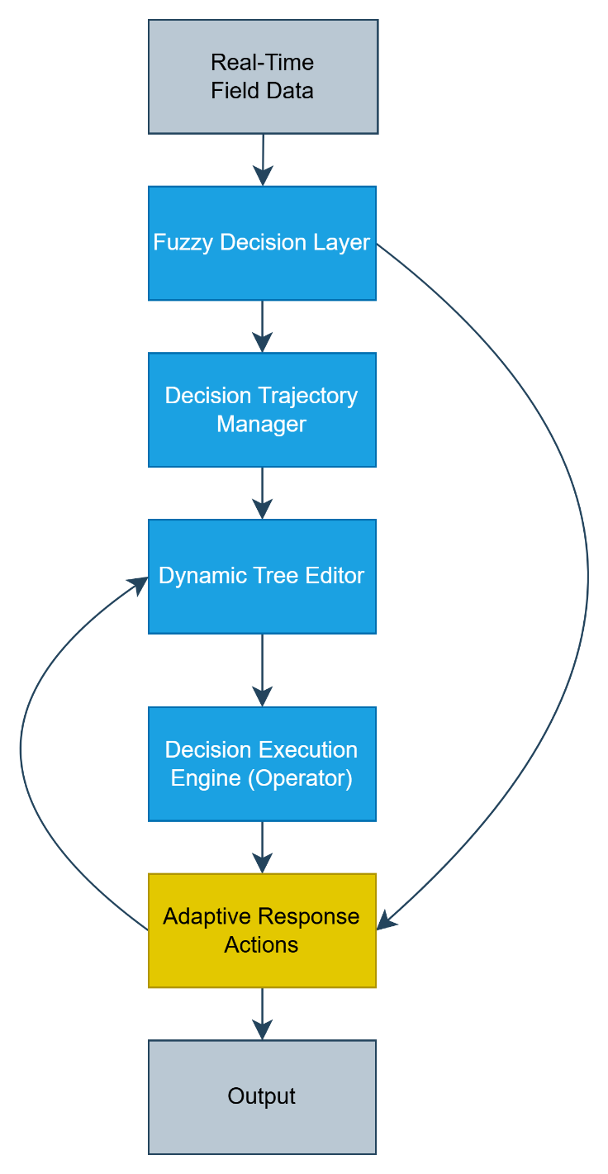
System Architecture
Layer | Feedback Sources | What Gets Updated?
Fuzzy Decision Layer | Action results, environment | Membership functions, fuzzy rules
Decision Trajectory Mgr | Trajectory success/failure | Q-values, sequence policy
Dynamic Tree Editor | Branch effectiveness | Tree structure, edge weights
Execution Engine | Operator approval/rejection | Action priorities, explanations
Adaptive Response | Outcome scores, real-world state | RL policy weights, LLM prompt refinements

Slide 7
Data Field
Cat. | Data Type | Possible Values | Constraints
Fire Condition | Fire location | Latitude, Longitude | Must be valid GPS coordinates
 | Fire spread rate | e.g., 0.5 m/s | Non-negative float
 | Fire perimeter | Polygon shape, area in hectares | Closed polygon, area > 0
 | Fire intensity | Low, Medium, High or kW/m | Categorical or continuous
 | Burned area | e.g., 25.4 ha | Non-negative float
 | Fire type | Surface, Crown, Ground | One of defined categories
 | Smoke plume direction | Azimuth degrees | 0°–360°
 | Reignition likelihood | 0.0–1.0 | Float, probability
Meteorological | Wind speed | e.g., 15 km/h | Non-negative
 | Wind direction | Degrees (0–360°) | Circular range
 | Air temperature | e.g., 28°C | -50°C to +60°C
 | Humidity | 0%–100% | Percentage
 | Atmospheric pressure | hPa | 300–1100 hPa
 | Precipitation rate | e.g., 5 mm/h | ≥ 0
 | Solar radiation | e.g., 600 W/m² | ≥ 0
 | Visibility index | 0–10 scale | Integer
Time | Timestamp | ISO 8601 | Valid datetime
 | Update frequency | Seconds | Positive integer
Infra. | Urban proximity | Distance in meters | ≥ 0
 | Evacuation status | Pending, In-progress, Complete | Enum
Cat. | Data Type | Possible Values | Constraints
Terrain & Vegetation | Slope | e.g., 27° | 0°–90°
 | Aspect | 0°–360° | Circular angle
 | Elevation | Meters above sea level | ≥ 0
 | Vegetation type | Pine, Grassland, Shrub | Predefined set
 | Fuel moisture content | e.g., 12% | 0–100%
 | Fuel load | e.g., 2.5 kg/m² | ≥ 0
 | NDVI | -1 to +1 | Float
 | Flammability index | Low, Moderate, High | Categorical
Operational | Personnel count | Integer | ≥ 0
 | Vehicle positions | GPS coordinates | Valid format
 | Aircraft tank capacity | Liters | ≥ 0
 | Water source availability | Liters | ≥ 0
 | Equipment status | Operational, Damaged | Enum
Sensory | Drone battery level | Percentage | 0–100%
 | Sensor temperature | °C | -40°C to +85°C
 | Link quality | dBm or %, RSSI | Defined range
 | Sensor uptime | Time (hh:mm:ss) | ≥ 0

Slide 8
Fuzzy Decision Layer
Advantages | Disadvantages
Handles uncertainty and imprecision gracefully. | Rule design and membership tuning require expertise.
Mimics human reasoning and linguistic variables. | Not inherently adaptive unless combined with learning (e.g. RL).
Allows partial rule activation and layered inference.
Fuzzy Logic Disadvantage | LLM Solution | RL Solution
1. Rule design and membership tuning require expertise | - Generates fuzzy rules from language - Suggests linguistic terms - Fills in rule gaps | - Optimizes membership thresholds and shapes - Learns rule effectiveness
2. Not inherently adaptive unless combined with learning | - Explains adaptive behavior in human terms - Suggests rules in new scenarios | - Adapts decisions based on environment - Improves through reward feedback

Slide 9
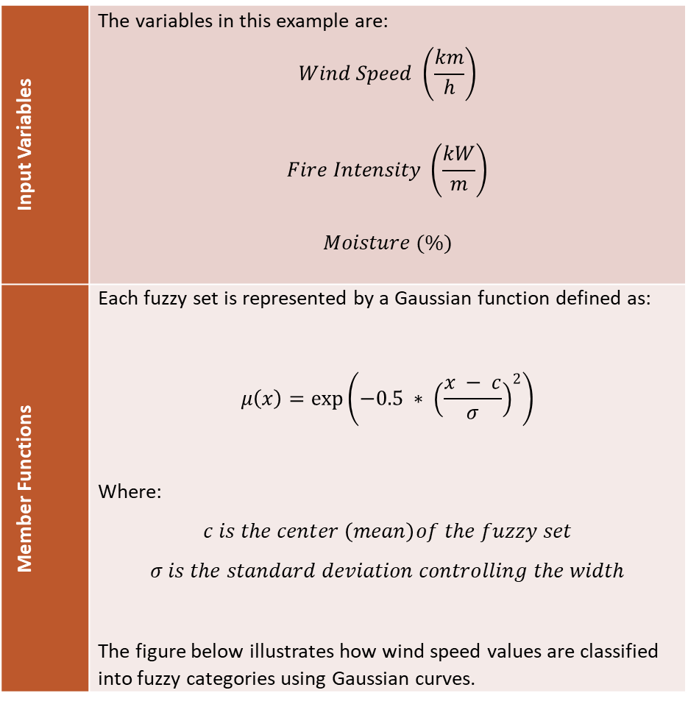
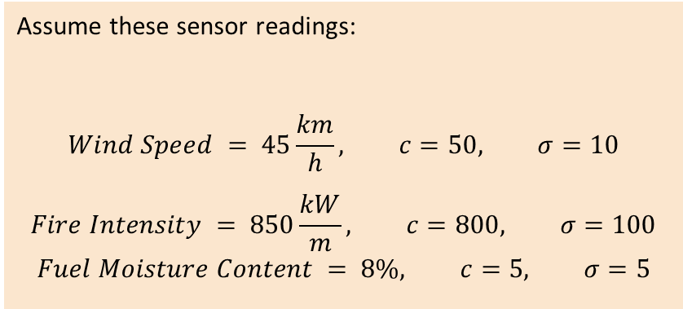
Fuzzy Decision Layer : Example (Single Decision)
Input Variables | The variables in this example are: $$Wind Speed \left(\frac{km}{h}\right)$$ $$Fire Intensity \left(\frac{kW}{m}\right)$$ $$Moisture (\%)$$
Member Functions | Each fuzzy set is represented by a Gaussian function defined as: $$μ\left(x\right)=\exp\left(−0.5 ∗ {\left(\frac{x − c}{σ}\right)}^{2}\right)$$ Where: $$c is the center \left(mean\right)of the fuzzy set$$ $$σ is the standard deviation controlling the width$$ The figure below illustrates how wind speed values are classified into fuzzy categories using Gaussian curves.
Assume these sensor readings:
$$Wind Speed = 45\frac{km}{h}, c=50, σ=10$$
$$Fire Intensity = 850\frac{kW}{m}, c=800, σ=100$$
$$Fuel Moisture Content = 8\%, c=5, σ=5$$

Slide 10
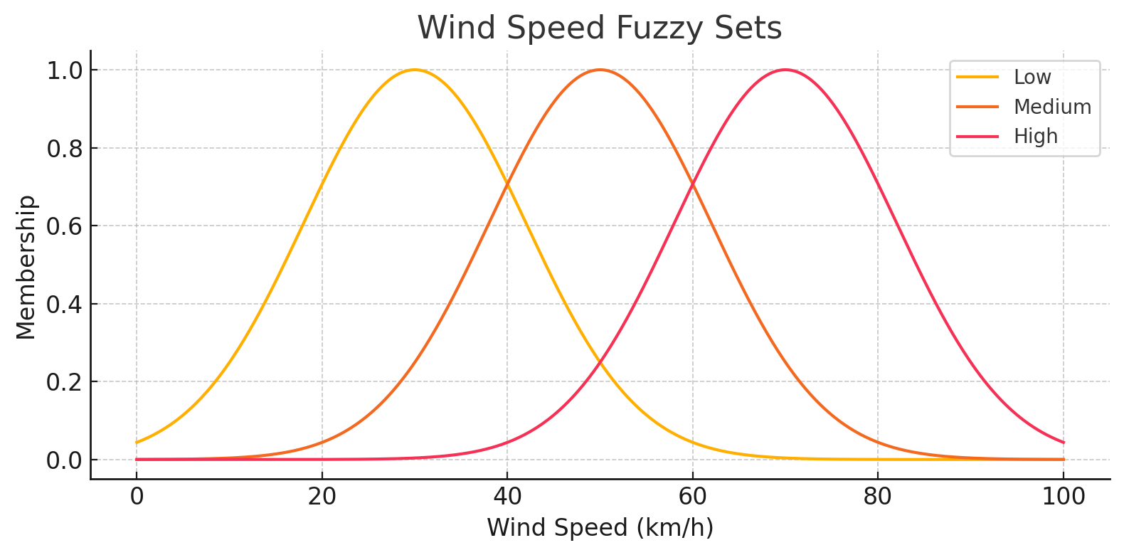
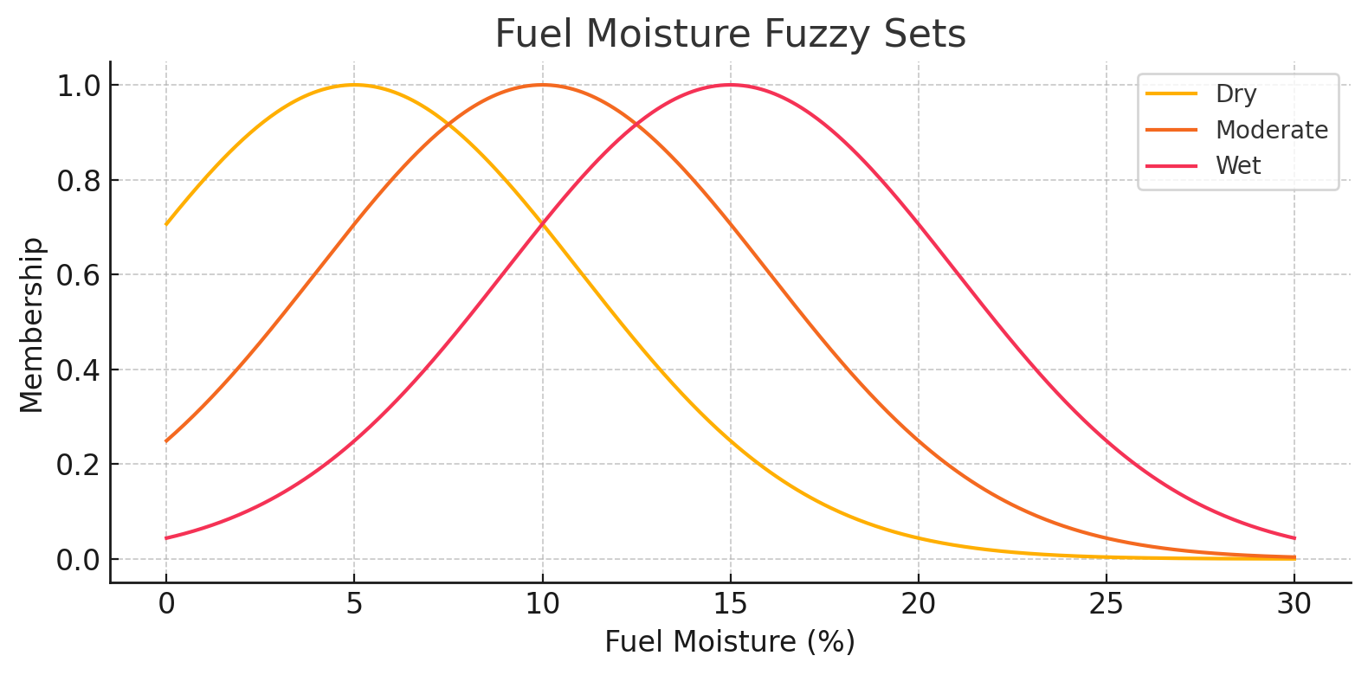
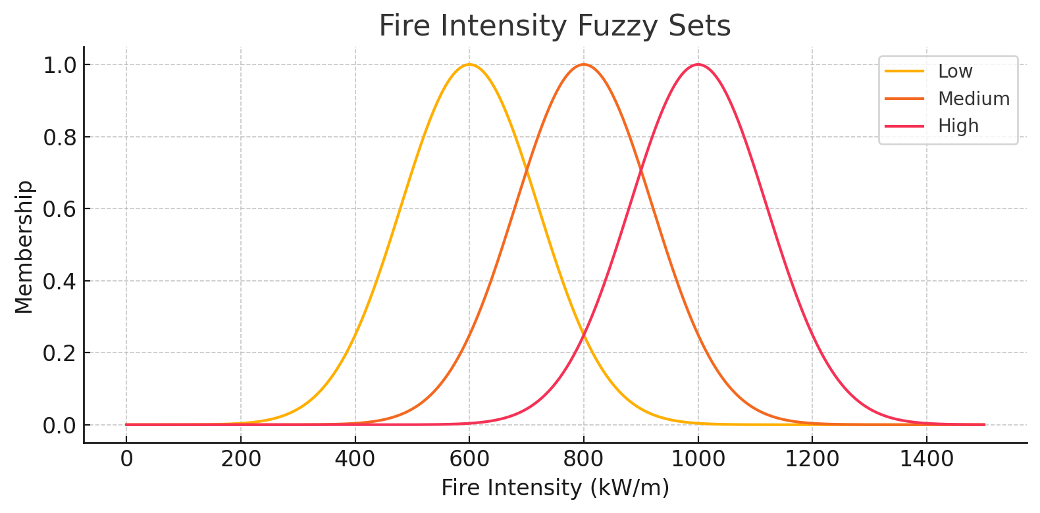
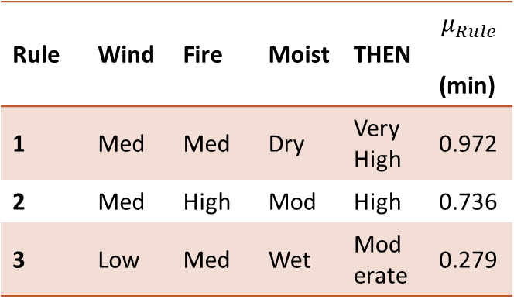
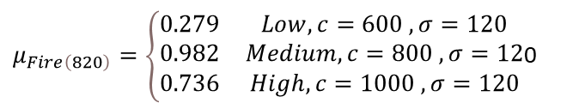
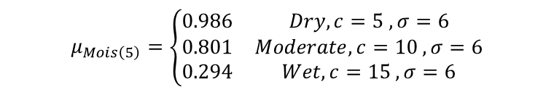
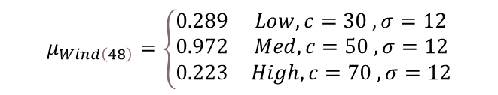
Fuzzy Decision Layer : Example (Single Decision)
$$μ_{Wind\left(48\right)}=\left\{\begin{matrix}0.289 & Low, c=30 , σ=12 \\ 0.972 & Med, c=50 , σ=12 \\ 0.223 & High, c=70 , σ=12\end{matrix}\right.$$
$$μ_{Mois\left(5\right)}=\left\{\begin{matrix}0.986 & Dry,c=5 , σ=6 \\ 0.801 & Moderate, c=10 , σ=6 \\ 0.294 & Wet,c=15 , σ=6\end{matrix}\right.$$
$μ_{Fire\left(820\right)}=\left\{\begin{matrix}0.279 & Low, c=600 , σ=120 \\ 0.982 & Medium, c=800 , σ=12 \\ 0.736 & High, c=1000 , σ=120\end{matrix}\right.$0
Rule | Wind | Fire | Moist | THEN | $$μ_{Rule}$$ (min)
1 | Med | Med | Dry | Very High | 0.972
2 | Med | High | Mod | High | 0.736
3 | Low | Med | Wet | Moderate | 0.279
Priority Level | c | μ (Weight)
Very High | 0.9 | 0.972
High | 0.7 | 0.736
Moderate | 0.5 | 0.279
$\text{Crisp} \text{Output}\text{= }\frac{\text{0.9⋅0.972+0.7⋅0.736+0.5⋅0.279}}{\text{0.972+0.736+0.279}}=0.76$

Slide 11
Fuzzy Decision Layer : Example (Single Decision)
Rule Set
IF |  |  | THEN
Wind Speed | Fire Intensity | Fuel Moisture | Suppression Priority
High | High | Dry | Very High
Medium | High | Dry | Very High
High | Medium | Dry | Very High
Medium | Medium | Dry | High
Low | High | Dry | High
Medium | Medium | Moderate | High
Low | Medium | Moderate | Moderate
Medium | Low | Moderate | Moderate
Low | Medium | Wet | Moderate
Low | Low | Wet | Low
Medium | Low | Wet | Low
Low | Low | Dry | Moderate
Decision Set
Output Scores
Scores | (Decision)
0.8 – 1.0 | 🚨 Immediate Evacuation
0.6 – 0.8 | ✅ Dispatch Aerial Units
0.4 – 0.6 | ⚠️ Prepare Ground Resources
0.0 – 0.4 | 🟢 Monitor and Wait
Output Fuzzy Set | Center (c)
Low | 0.3
Moderate | 0.5
High | 0.7
Very High | 0.9

Slide 12
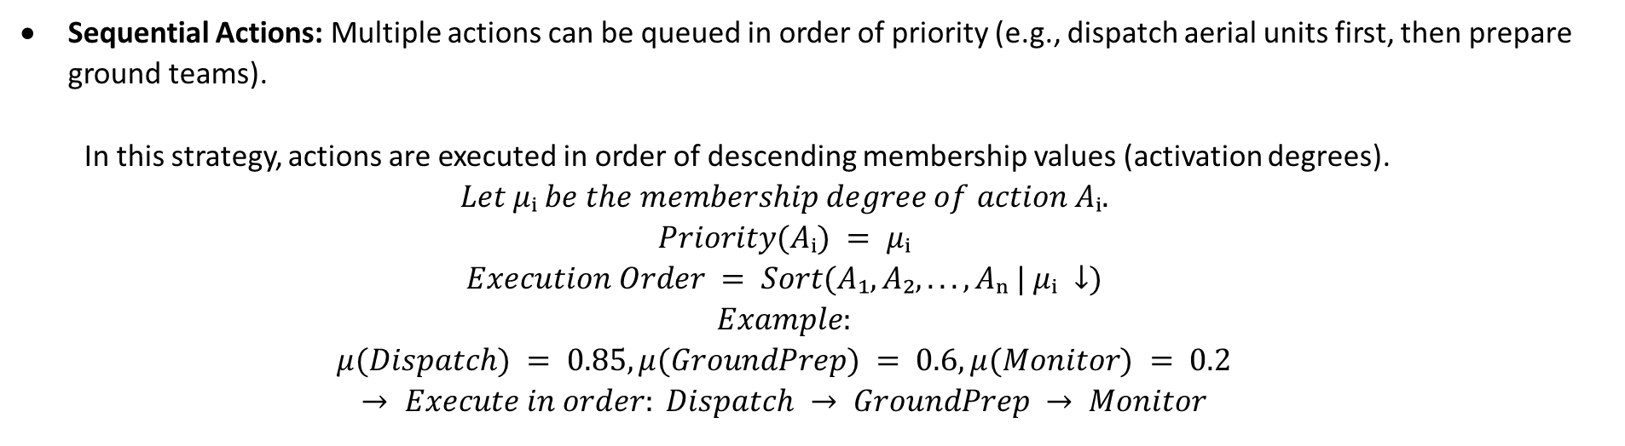
Fuzzy Decision Layer : Example (Multiple Decisions)
Sequential Actions: Multiple actions can be queued in order of priority (e.g., dispatch aerial units first, then prepare ground teams).
In this strategy, actions are executed in order of descending membership values (activation degrees).
$$Let μᵢ be the membership degree of action Aᵢ.$$
$$Priority(Aᵢ) = μᵢ$$
$$Execution Order = Sort(A₁, A₂, ..., Aₙ | μᵢ ↓)$$
$$Example:$$
$$μ(Dispatch) = 0.85, μ(GroundPrep) = 0.6, μ(Monitor) = 0.2$$
$$→ Execute in order: Dispatch → GroundPrep → Monitor$$

Slide 13
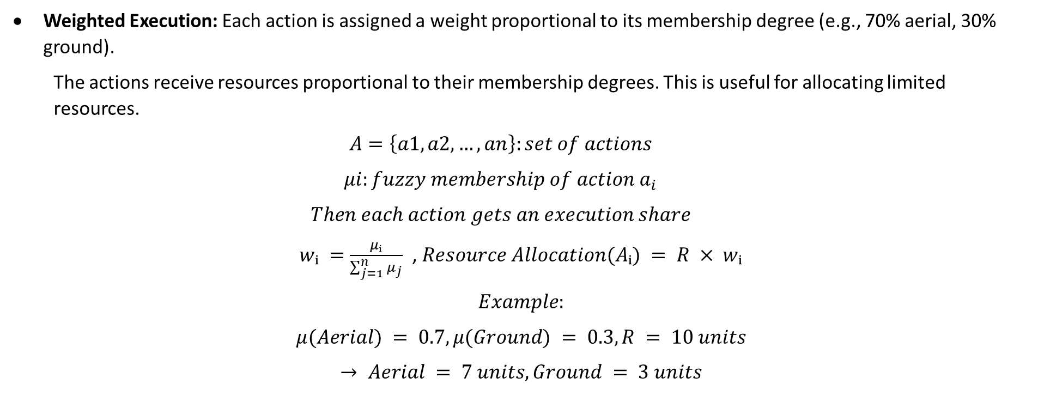
Fuzzy Decision Layer : Example (Multiple Decisions)
Weighted Execution: Each action is assigned a weight proportional to its membership degree (e.g., 70% aerial, 30% ground).
The actions receive resources proportional to their membership degrees. This is useful for allocating limited resources.
$$A=\left\{a1,a2,…,an\right\}:set of actions$$
$$μi:fuzzy membership of action a_{i}$$
$$Then each action gets an execution share$$
$wᵢ =\frac{μᵢ}{\sum_{j=1}^{n}{μ_{j}}}$ , $Resource Allocation(Aᵢ) = R × wᵢ$
$$Example:$$
$$μ(Aerial) = 0.7, μ(Ground) = 0.3, R = 10 units$$
$$→ Aerial = 7 units, Ground = 3 units$$

Slide 14
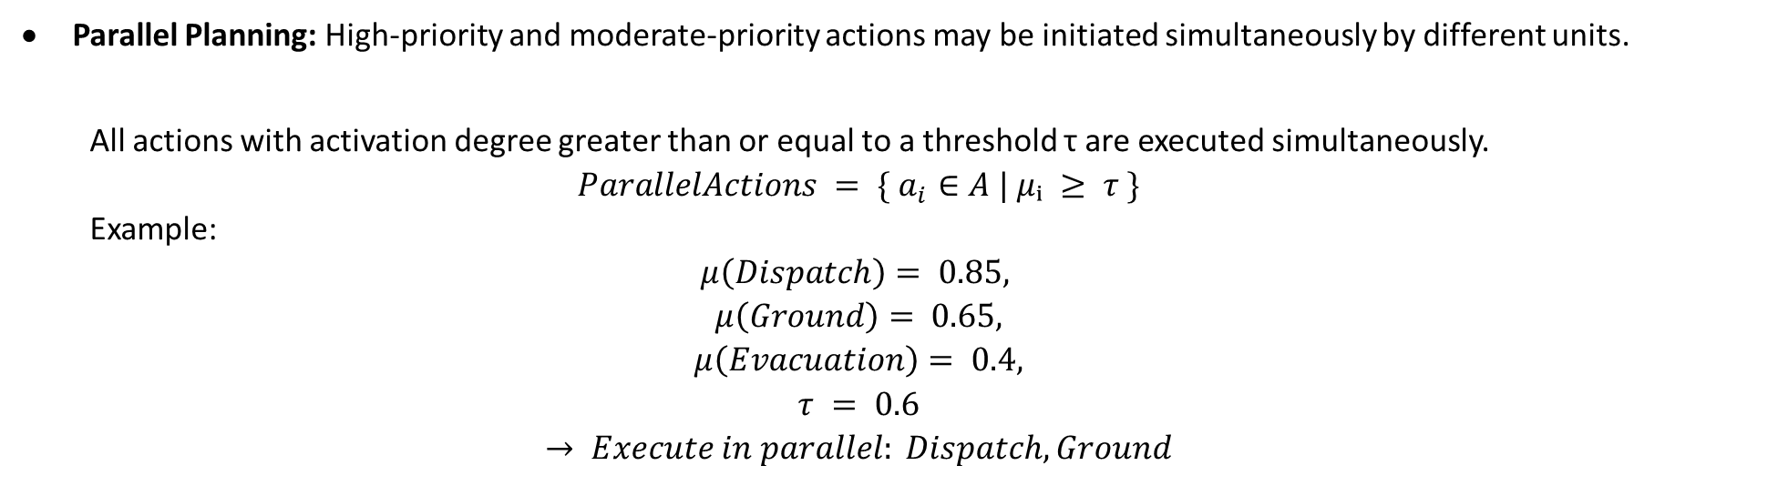
Fuzzy Decision Layer : Example (Multiple Decisions)
Parallel Planning: High-priority and moderate-priority actions may be initiated simultaneously by different units.
All actions with activation degree greater than or equal to a threshold τ are executed simultaneously.
$$ParallelActions = \{ a_{i}∈A | μᵢ ≥ τ \}$$
Example:
$$μ\left(Dispatch\right)= 0.85,$$
$$μ\left(Ground\right)= 0.65,$$
$$μ\left(Evacuation\right)= 0.4,$$
$$τ = 0.6$$
$$→ Execute in parallel: Dispatch, Ground$$

Slide 15
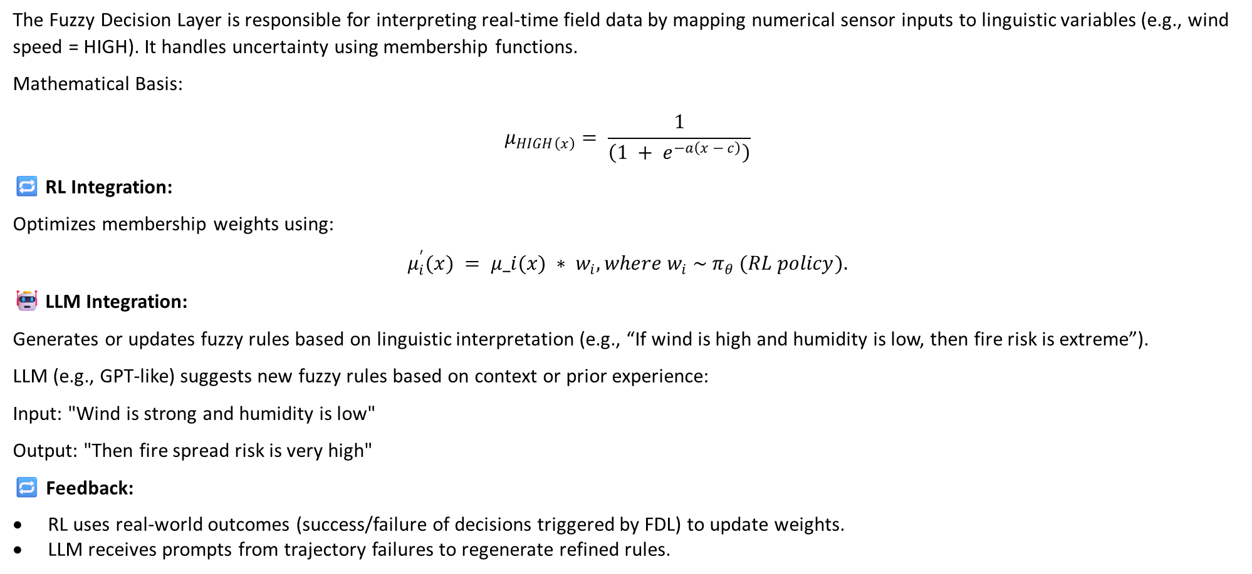
Fuzzy Decision Layer : RL & LLM & Feedback Integration
The Fuzzy Decision Layer is responsible for interpreting real-time field data by mapping numerical sensor inputs to linguistic variables (e.g., wind speed = HIGH). It handles uncertainty using membership functions.
Mathematical Basis:
$$μ_{HIGH\left(x\right)}= \frac{1}{\left(1 + e^{−a\left(x − c\right)}\right)}$$
🔁 RL Integration:
Optimizes membership weights using:
$$μ_{i}^{′}(x) = μ_i(x) ∗ w_{i}, where w_{i} \sim π_{θ} (RL policy).$$
🤖 LLM Integration:
Generates or updates fuzzy rules based on linguistic interpretation (e.g., “If wind is high and humidity is low, then fire risk is extreme”).
LLM (e.g., GPT-like) suggests new fuzzy rules based on context or prior experience:
Input: "Wind is strong and humidity is low"
Output: "Then fire spread risk is very high"
🔁 Feedback:
RL uses real-world outcomes (success/failure of decisions triggered by FDL) to update weights.
LLM receives prompts from trajectory failures to regenerate refined rules.

Slide 16
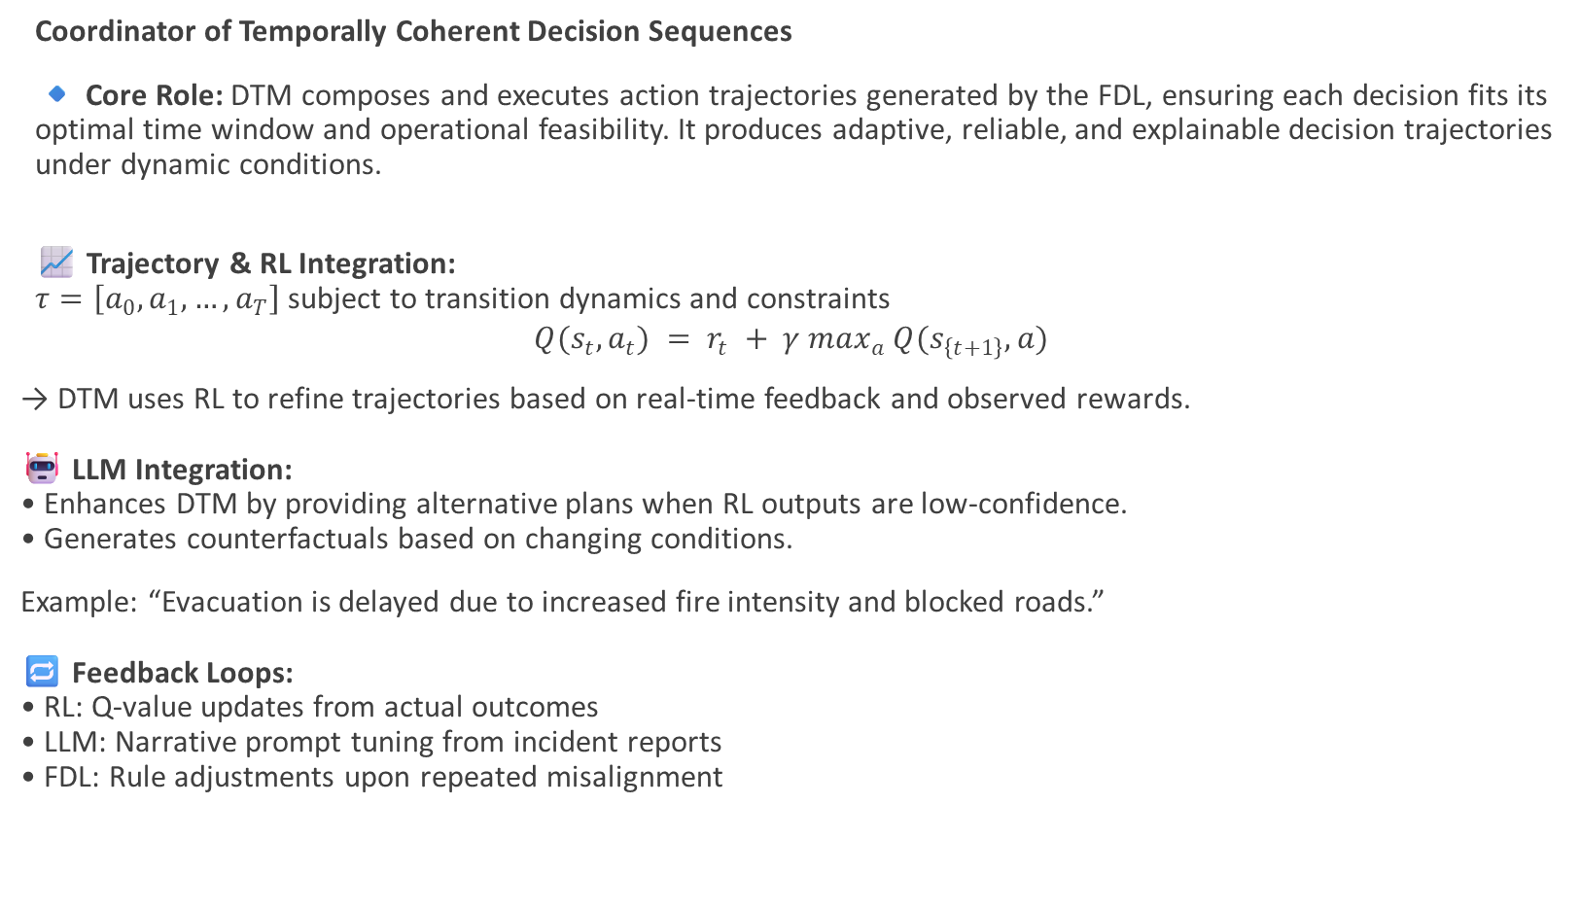
Decision Trajectory Manager (DTM)
Coordinator of Temporally Coherent Decision Sequences
🔹 Core Role: DTM composes and executes action trajectories generated by the FDL, ensuring each decision fits its optimal time window and operational feasibility. It produces adaptive, reliable, and explainable decision trajectories under dynamic conditions.
📈 Trajectory & RL Integration:
$τ=\left[a_{0}, a_{1},…,a_{T}\right]$ subject to transition dynamics and constraints
$$Q(s_{t}, a_{t}) = r_{t} + γ max_{a} Q(s_{\left\{t+1\right\}}, a)$$
→ DTM uses RL to refine trajectories based on real-time feedback and observed rewards.
🤖 LLM Integration:
• Enhances DTM by providing alternative plans when RL outputs are low-confidence.
• Generates counterfactuals based on changing conditions.
Example: “Evacuation is delayed due to increased fire intensity and blocked roads.”
🔁 Feedback Loops:
• RL: Q-value updates from actual outcomes
• LLM: Narrative prompt tuning from incident reports
• FDL: Rule adjustments upon repeated misalignment

Slide 17
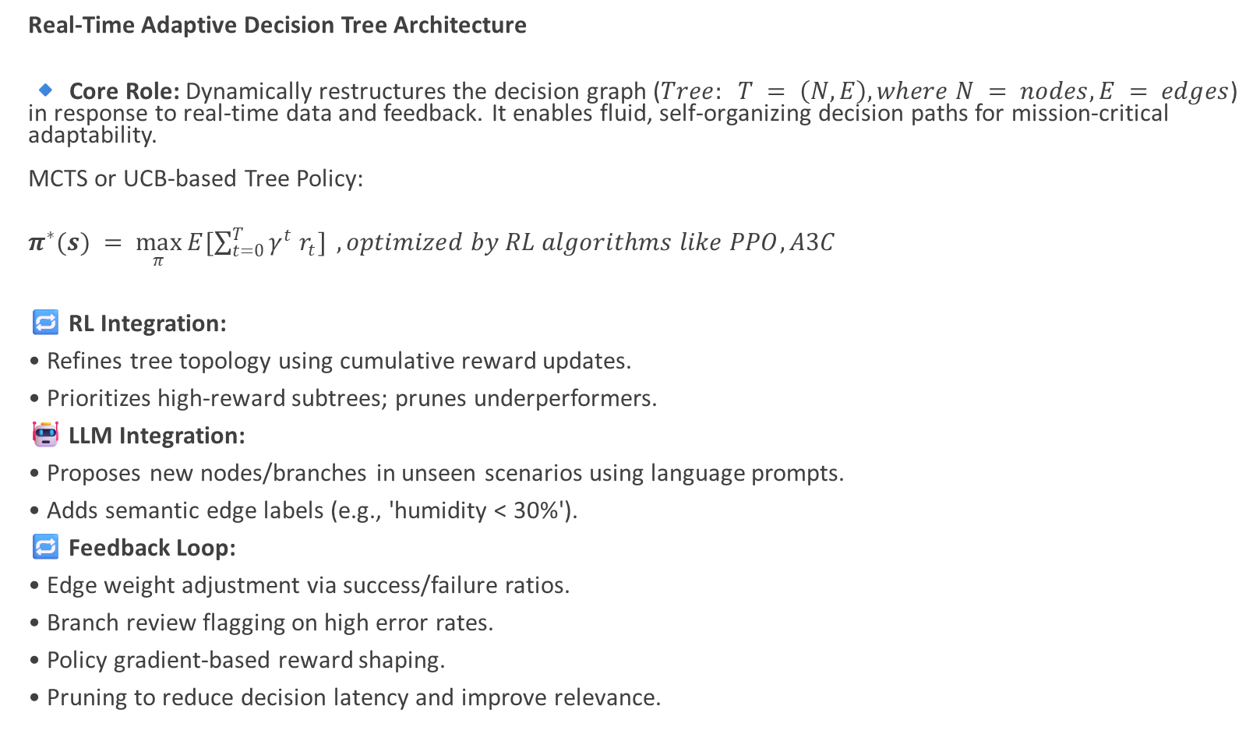
Dynamic Tree Editor (DTE)
Real-Time Adaptive Decision Tree Architecture
🔹 Core Role: Dynamically restructures the decision graph ($Tree: T = \left(N, E\right), where N = nodes, E = edges$) in response to real-time data and feedback. It enables fluid, self-organizing decision paths for mission-critical adaptability.
MCTS or UCB-based Tree Policy:
$π^{∗}(s) = \max_{π}{E[\sum_{t=0}^{T}{γ^{t} r_{t}}]} , optimized by RL algorithms like PPO, A3C$
🔁 RL Integration:
• Refines tree topology using cumulative reward updates.
• Prioritizes high-reward subtrees; prunes underperformers.
🤖 LLM Integration:
• Proposes new nodes/branches in unseen scenarios using language prompts.
• Adds semantic edge labels (e.g., 'humidity < 30%').
🔁 Feedback Loop:
• Edge weight adjustment via success/failure ratios.
• Branch review flagging on high error rates.
• Policy gradient-based reward shaping.
• Pruning to reduce decision latency and improve relevance.

Slide 18
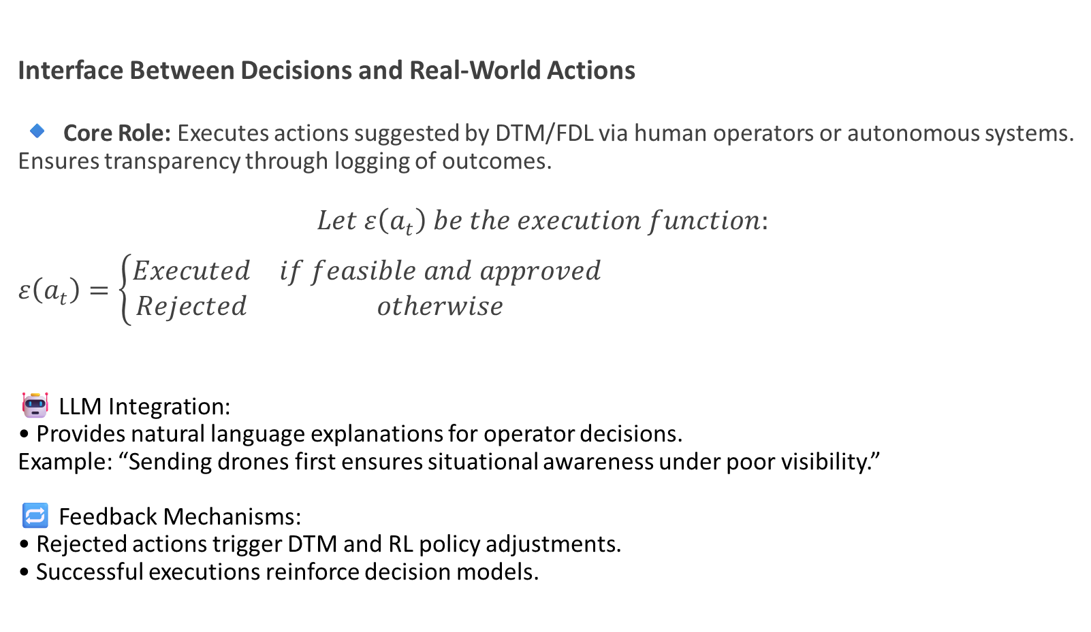
Decision Execution Engine (DEE)
Interface Between Decisions and Real-World Actions
🔹 Core Role: Executes actions suggested by DTM/FDL via human operators or autonomous systems.
Ensures transparency through logging of outcomes.
$Let ε\left(a_{t}\right) be the execution function:$
$ε\left(a_{t}\right)=\left\{\begin{matrix}Executed & if feasible and approved \\ Rejected & otherwise\end{matrix}\right.$
🤖 LLM Integration:
• Provides natural language explanations for operator decisions.
Example: “Sending drones first ensures situational awareness under poor visibility.”
🔁 Feedback Mechanisms:
• Rejected actions trigger DTM and RL policy adjustments.
• Successful executions reinforce decision models.

Slide 19
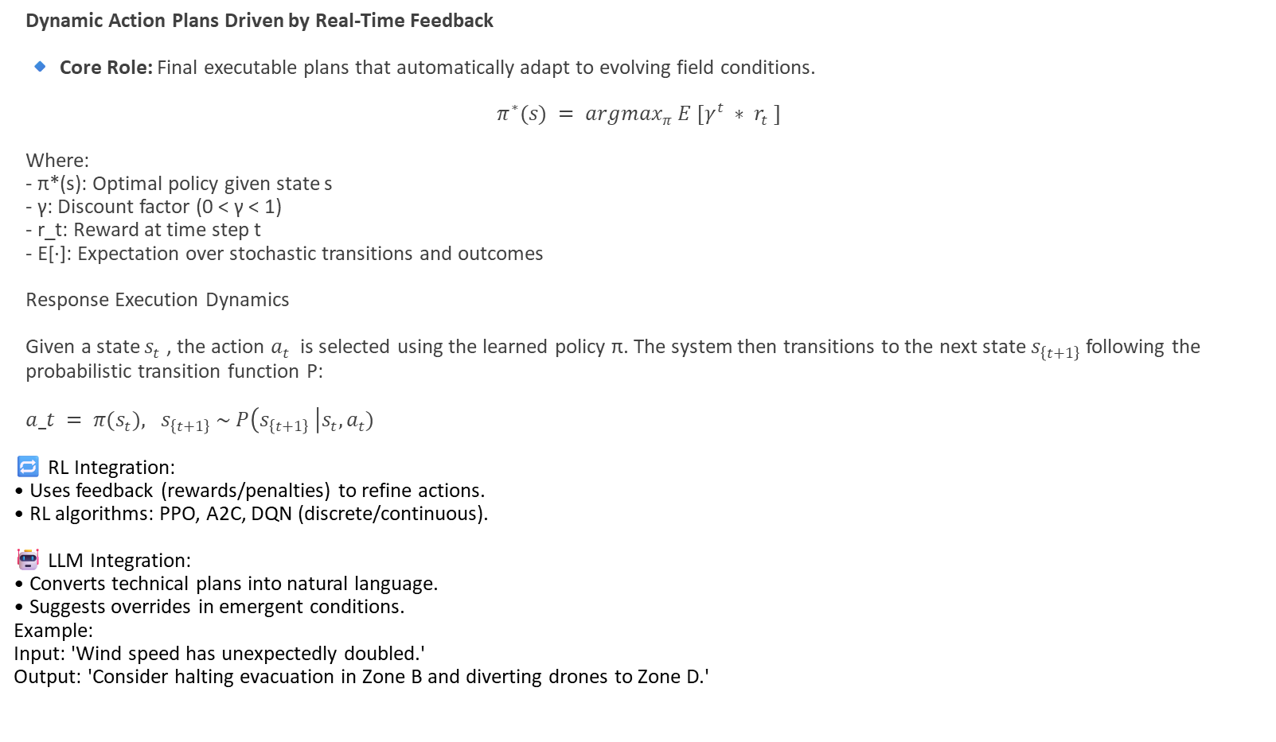
Adaptive Response Actions (ARA)
Dynamic Action Plans Driven by Real-Time Feedback
🔹 Core Role: Final executable plans that automatically adapt to evolving field conditions.
$π^{∗}(s) = argmax_{π} E [γ^{t} ∗ r_{t} ]$
Where:
- π*(s): Optimal policy given state s
- γ: Discount factor (0 < γ < 1)
- r_t: Reward at time step t
- E[·]: Expectation over stochastic transitions and outcomes
Response Execution Dynamics
Given a state $s_{t}$ , the action $a_{t}$ is selected using the learned policy π. The system then transitions to the next state $s_{\left\{t+1\right\}}$ following the probabilistic transition function P:
$a_t = π(s_{t}), s_{\left\{t+1\right\}} \sim P\left(s_{\left\{t+1\right\}} \right|s_{t}, a_{t})$
🔁 RL Integration:
• Uses feedback (rewards/penalties) to refine actions.
• RL algorithms: PPO, A2C, DQN (discrete/continuous).
🤖 LLM Integration:
• Converts technical plans into natural language.
• Suggests overrides in emergent conditions.
Example:
Input: 'Wind speed has unexpectedly doubled.'
Output: 'Consider halting evacuation in Zone B and diverting drones to Zone D.'

Slide 20
Work Plan and Future Work
Task Area | Description
1. Synthetic Data Generation | Synthetic sensors (e.g., drone, thermal) to the data ingestion layer.
2. Online RL Engine | Implement feedback-driven RL with real-time trajectory adjustment.
3. Dynamic GNN for Decision Graph | Integrate GNN to evolve and optimize decision tree topology.
4. Cross-Layer Feedback Bus | Establish unified interfaces between layers (e.g., LLM ↔ RL, FDL ↔ DTM).
5. LLM Explanation Module | Finalize prompt templates and integrate narrative-based justifications.
6. Operator-in-the-Loop UI | Design user interface for human validation and feedback.
7. Simulation & Scenario Platform | Build high-fidelity wildfire simulations with fire/weather/topography data.
8. Decision Scoring Framework | Develop multi-criteria scoring: reward, cost, confidence.
9. Open-Source Toolkit Packaging | Document codebase and release toolkit with sample data and APIs.

Slide 21
References
[1] | CRED, “2021 Disasters in numbers,” Centre for Research on the Epidemiology of Disasters, Brussels, 2022.
[2] | B. Golding, Towards the “Perfect” Weather Warning: Bridging Disciplinary Gaps through Partnership and Communication, Springer Nature, 2022.
[3] | IFAFRI, "The International Forum to Advance First Responder Innovation," IFAFRI, 2019.
[4] | E. Yanmaz, S. Yahyanejad, B. Rinner, H. Hellwagner and C. Bettstetter, "Drone networks: Communications, coordination, and sensing," Ad Hoc Networks, vol. 68, pp. 1-15, 2018.
[5] | B. Shucker and J. K. Bennett, “Scalable control of distributed robotic macrosensor,” Distributed Autonomous Robotic Systems, vol. 6, pp. 379-388, 2007.
[6] | B. Shucker and J. K. Bennett, “Virtual spring mesh algorithms for control of distributed robotic macrosensors. Technical Report CU-CS-996-05,” University of Colorado at Boulder, 2005.
[7] | B. Shucker and J. K. Bennett, "Target tracking with distributed robotic macrosensors," in MILCOM 2005-2005 IEEE Military Communications Conference, 2005.
[8] | K. Derr and M. Manic, “Extended virtual spring mesh (EVSM): The distributed self-organizing mobile ad hoc network for area exploration,” IEEE Transactions on Industrial Electronics, vol. 58, no. 12, pp. 5424-5437, 2011.
[9] | A. Trotta, L. Montecchiari, M. Di Felice and L. Bononi, “A GPS-free flocking model for aerial mesh deployments in disaster-recovery scenarios,” IEEE Access, vol. 8, pp. 91558-91573, 2020.
[10] | A. Zanella, “Best practice in RSS measurements and ranging,” IEEE Communications Surveys & Tutorials, vol. 18, no. 4, pp. 2662-2686, 2016.
[11] | H. Obeidat, W. Shuaieb, O. Obeidat and R. Abd-Alhameed, “A review of indoor localization techniques and wireless technologies,” Wireless Personal Communications, vol. 119, pp. 289-327, 2021.
[12] | L. E. C. Infrastructure and M. L. P. Layer, “IEEE standard for low-rate wireless networks,” IEEE, 2015.
[13] | A. Waqar, I. Ahmad, D. Habibi and Q. V. Phung, "Analysis of GPS and UWB positioning system for athlete tracking," Measurement: Sensors, vol. 14, no. 100036, 2021.
[14] | L. E. Miller, “Why UWB? A review of ultrawideband technology.,” DARPA, Maryland, 2003.
[15] | QORVO, “Decawave Product Brief: MDEK1001,” QORVO, 2017.
[16] | NXP, “Trimension SR150 Ultra-Wideband Transceiver,” NXP, 2021.
[17] | W. Jin, J. Yang, Y. Fang and W. Feng, “Research on application and deployment of UAV in emergency response,” in 2020 IEEE 10th International Conference on Electronics Information and Emergency Communication (ICEIEC), IEEE, 2020.
[18] | J. Schwarzrock, I. Zacarias, A. L. Bazzan, R. Q. de Araujo Fernandes, L. H. Moreira and E. P. de Freitas, “Solving task allocation problem in multi Unmanned Aerial Vehicles,” Engineering Applications of Artificial Intelligence, vol. 72, pp. 10-20, 2018.
[19] | M. Zhu, X. Du, X. Zhang, H. Luo and G. Wang, “Multi-UAV Rapid-Assessment Task-Assignment Problem in a Post-Earthquake Scenario,” IEEE access, vol. 7, pp. 74542-74557, 2019.
[20] | H. Liang, G. Kou, Y. Dong, F. Chiclana and E. Herrera-Viedma, “Consensus Reaching With Minimum Cost of Informed Individuals and Time Constraints in Large-Scale Group Decision-Making,” IEEE Transactions on Fuzzy Systems, vol. 30, no. 11, pp. 4994-5004, 2022.
[21] | F. Liu, Y. Wu and W. Pedrycz, “A Modified Consensus Model in Group Decision Making With an Allocation of Information Granularity,” IEEE Transactions on Fuzzy Systems, vol. 26, no. 5, pp. 3182-3187, 2018.
[22] | M. Wang, D. Liang and D. Li, “A Two-Stage Method for Improving the Decision Quality of Consensus-Driven Three-Way Group Decision-Making,” IEEE Transactions on Systems, Man, and Cybernetics: Systems, 2022.
[23] | Y. Rizk, M. Awad and E. W. Tunstel, “Decision Making in Multiagent Systems: A Survey,” IEEE Transactions on Cognitive and Developmental Systems, vol. 10, no. 3, pp. 514-529, 2018.
[24] | Holybro, “Px Guide,” Holybro, [Online]. Available: https://docs.px4.io/main/en/assembly/quick_start_pixhawk6x.html. [Accessed 05 2024].
[25] | J. Butcher, Runge-kutta methods, Scholarpedia, 2007.

Slide 22
Thank you,

